Slide 1
Case Study 2
Movie Recommendation System
By: Enbo Tian, Sirshendu Ganguly, Dang Tran

Slide 2
Motivation and Background
Why did so many of the great movies come from the last century?
Notes:
The technique of making Movies was not good enough. But still so many great movies.

Slide 3


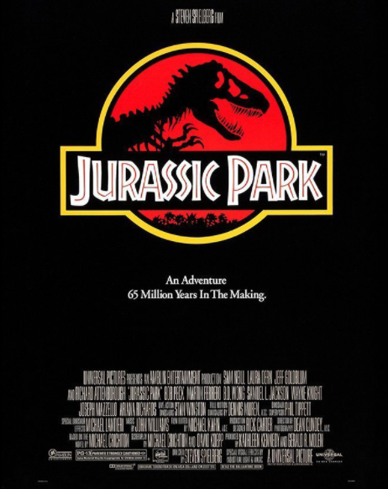

Motivation and Background
History of last century:
World War II
Cold War
Great art always comes from suffering

Slide 4
Data Source
Users, Movies, Ratings

Slide 5
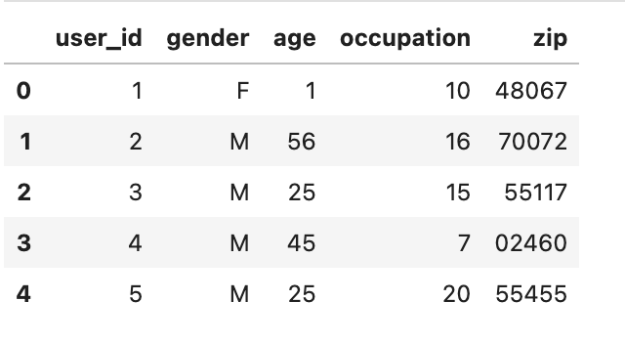
Data Source-Users
user_id: Unique ID to identify users
Gender: Gender of the users
age: Age group of the user
Occupation: Occupation group of the user
zip: Zip code of the user
Figure: First 5 rows of users dataframe
Notes:
User ID : Unique ID
Gender: M(ale) and F(emale)
Age: bins 1, 18 ,25 35 45 50 56
Ocu: 0 for other 20 occupations
zip code

Slide 6
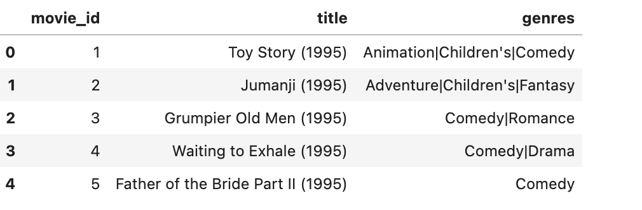
Data Source-Movies
movie_id: Unique ID to identify movies
title: Name of the movie along with year of release
genres: Genres of the movie
Figure: First 5 rows of movies dataframe

Slide 7
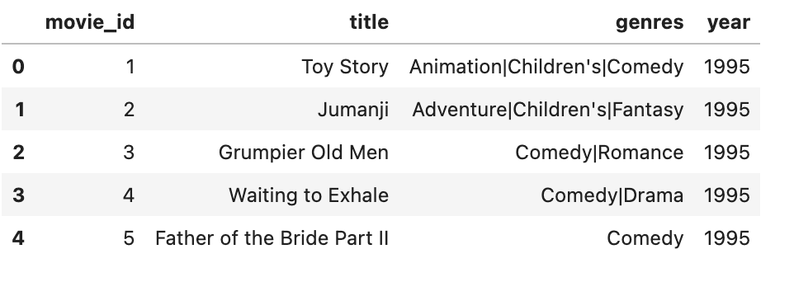
Data Source-Movies
movie_id: Unique ID to identify movies
title: Name of the movie
genres: Genres of the movie
year: The year of release
Figure: First 5 rows of movies dataframe after data preprocessing

Slide 8
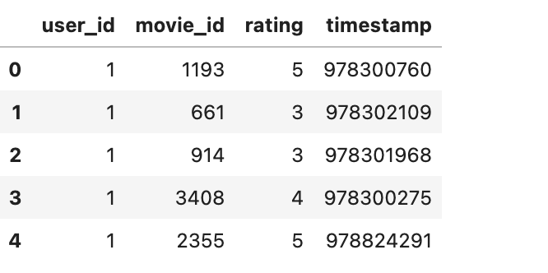
Data Source-Ratings
user_id: Unique ID of user
movie_id: Unique ID of movies
rating: The rating of the movie
timestamp: The timestamp of it being reviewed
Figure: First 5 rows of ratings dataframe
Notes:
User ID : Unique ID
Gender: M(ale) and F(emale)
Age: bins 1, 18 ,25 35 45 50 56
Ocu: 0 for other 20 occupations
zip code

Slide 9
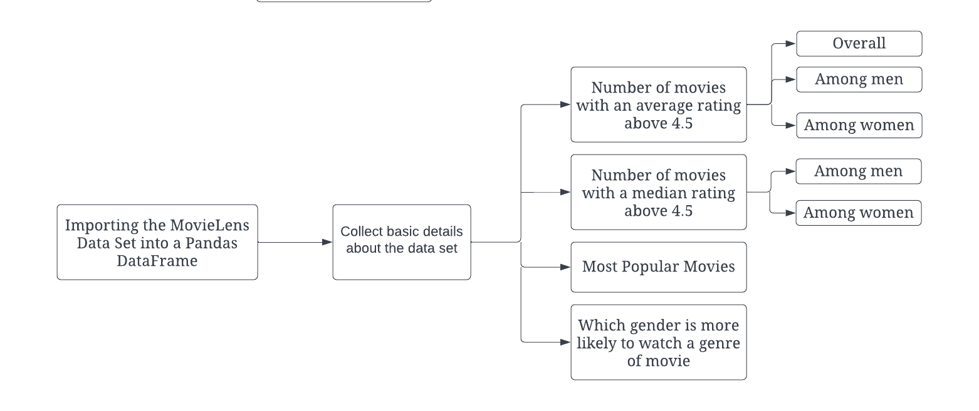
Methodology - Problem 1
Utilized pandas libraries for dataframe creations and mathematical calculations
Utilized seaborn and matplotlib for plotting
Create a balanced dataset between genders for the conjecture
Figure: Block diagram of workflow for Problem 1
Notes:
Create functions that calculated the mean and median using pandas mean and median. Grouping by movie id.

Slide 10
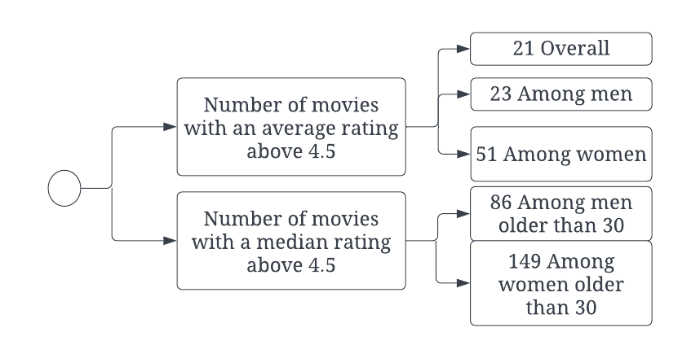
Results - Problem 1
Figure: Basic details about MovieLens dataset which answers problem 1

Slide 11
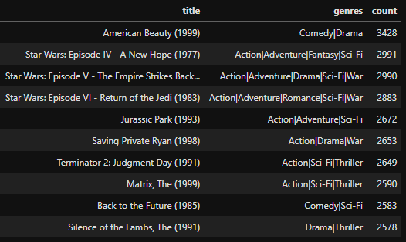
Results - Problem 1
We identified the 10 most popular movies based on numbers of ratings
Intuition: Most reviewed movies
Figure: Top 10 most popular movies

Slide 12
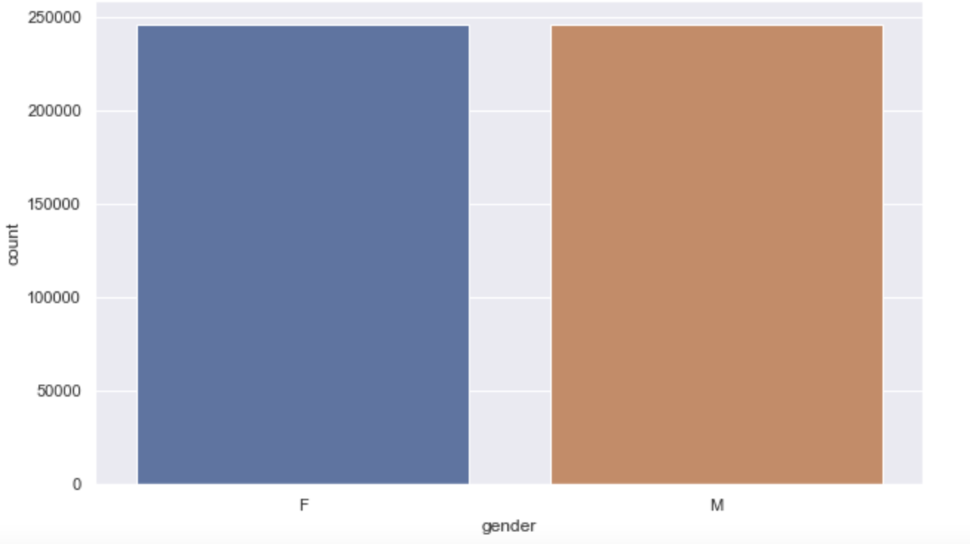
Results - Problem 1
Some conjectures about how easy various groups are to please:
Conjecture 1: Males are more into Action movie
Conjecture 2: Females are more into Romance movies
Figure: Bar graph of ratings by the 2 genders in a balanced dataset
Notes:
Original dataset male female not equal, need balanced dataset

Slide 13
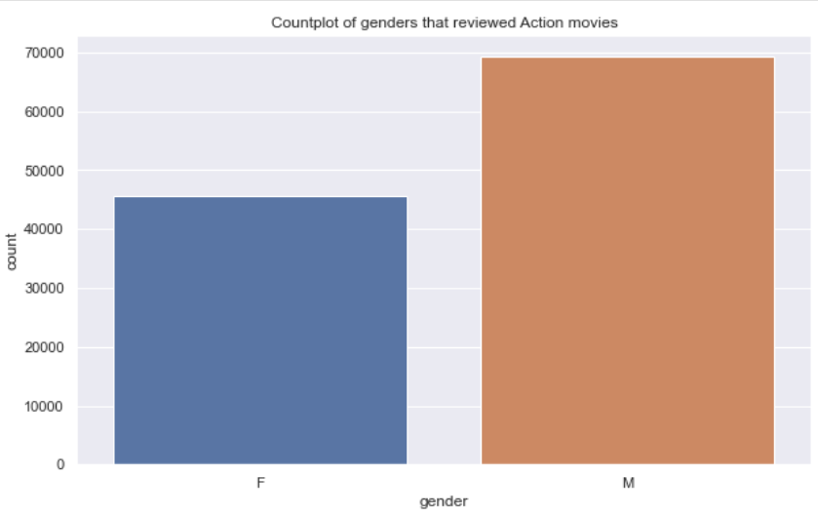
Results - Problem 1
Conjecture 1: Males are more into Action movie
Figure: Bar graph of genders that reviewed Action movies
Notes:
Add figure label
What we are doing?
How we are doing?

Slide 14
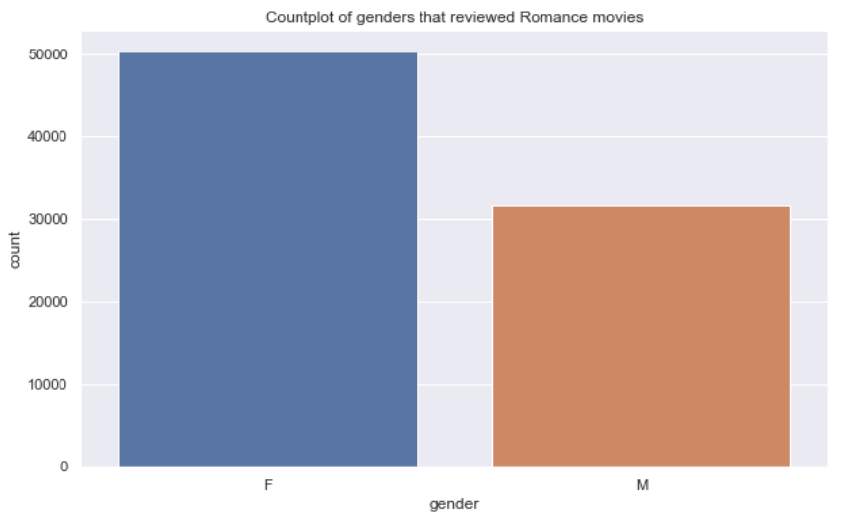
Results - Problem 1
Conjecture 2: Females are more into Romance movies
Figure: Bar graph of genders that reviewed Romance movies
Notes:
Add figure label
What we are doing?
How we are doing?

Slide 15
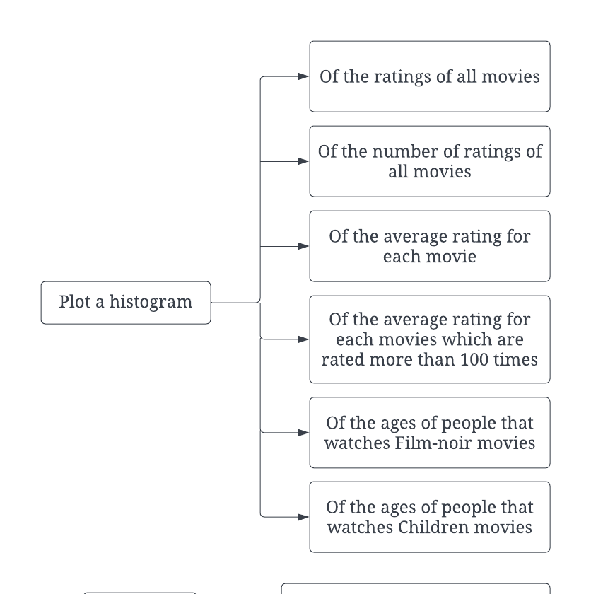
Methodology - Problem 2
Used seaborn and matplotlib libraries for histogram plotting
2 Conjectures:
Film-noir target audience is people older than 56 years old.
Children movies target audience is people older younger than 18 years old.
Figure: Block diagram of the workflow for problem 2
Notes:
groupby(‘title’).count() or .mean()
groupby('movie_id').mean().rating
Make a new dataframe of only movies with more than 100 reviews
Balanced dataset - number of samples from each age range is the same
Plot histogram for only ratings for film-noir/children movies

Slide 16
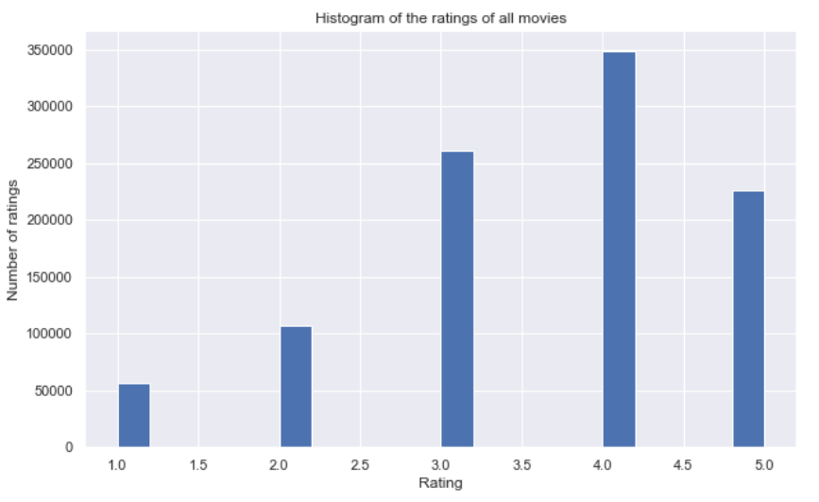
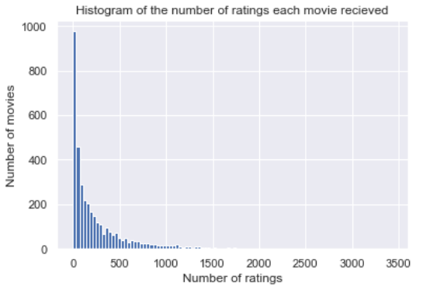
Results - Problem 2
Exploring more into the ratings dataframe
Figure: Histogram of the ratings of all movies
Figure: Histogram of number of ratings each movie received
Notes:
Most people tend to give positive reviews with the majority of them being 4 stars. This makes sense as some people can be more reserved in giving 1 or 5 stars and tend to fall into the middle more. The majority of positive reviews also make sense as usually, people would only go to watch a movie if they’re interested in the movie and would be more likely to enjoy it.
We can see that most movies only received a small amount of ratings so we can infer that there’s more lesser known movies than popular movies. This makes sense as the number of indie movies that come out can easily outnumber the annual summer blockbuster movies.

Slide 17
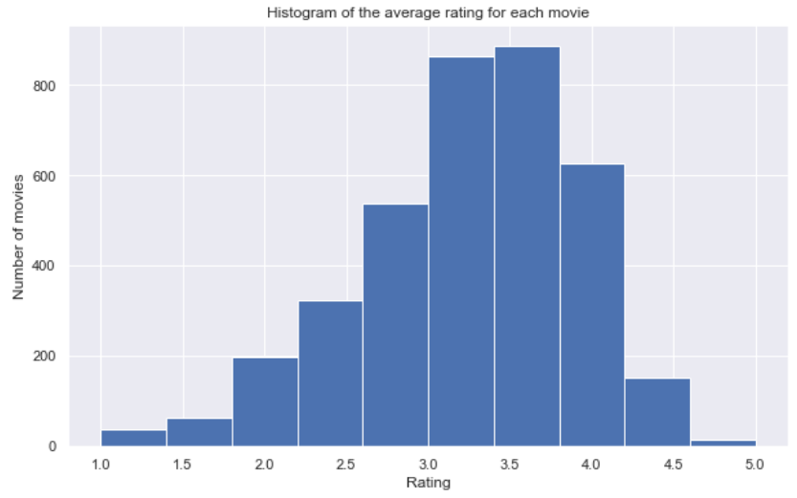
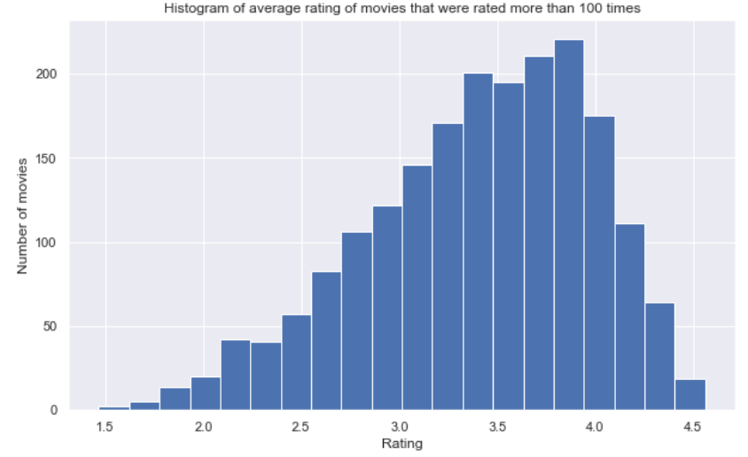
Results - Problem 2
Comparison between histograms for all movies vs movies rated more than 100 times
Figure: Histogram of the average rating for each movie
Figure: Histogram of movies that were rated more than 100 times
Notes:
With the average ratings, we have a better sense of how the ratings are actually distributed. Here we can see that most movies actually have an average reviews of around 3.5 instead of the 4 that we’d presume from the raw rating histogram. We can also see the incredibly small amount of movies that have an average rating of 1 or 5 as people are less likely to rate closer to the extremities.
we get an even better sense of how the ratings are distributed with more bars. Notice also how the tail ends of the histogram don’t include 1 and 5. This is because it’s near impossible for a movie to have an average rating of 1 or 5 unless there’s only one or a few ratings of 1 or 5, which is impossible when the histogram only includes the movies that were rated more than 100 times. It’d make more sense to trust movies that were reviewed more than 100 times as we get a more accurate sense of the quality of the movie from the majority opinions.

Slide 18
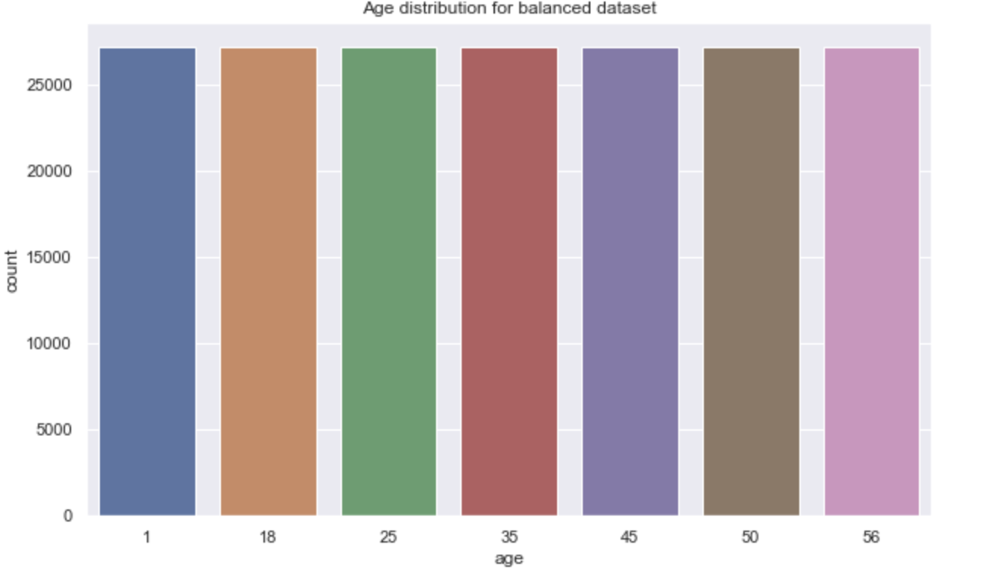
Results - Problem 2
Some conjectures about the distribution of ratings
Conjecture 1: People older than 56 years old are more into Film-Noir movies
Conjecture 2: People younger than 18 years old are more into Children's movies
Figure: Bar graph of age in the balanced dataset
Notes:
Original dataset male female not equal, need balanced dataset

Slide 19
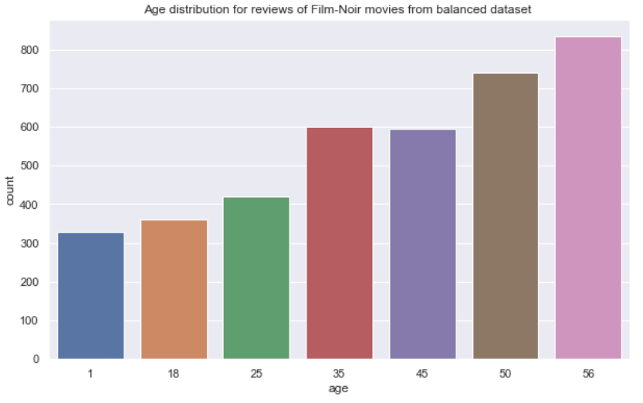
Results - Problem 2
Conjecture 1: People older than 56 years old are more into Film-Noir movies
Figure: Age distribution for reviews of Film-Noir movies

Slide 20
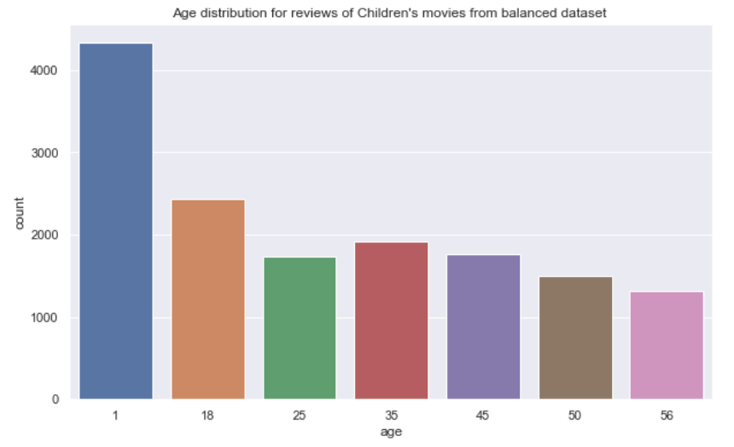
Results - Problem 2
Conjecture 2: People younger than 18 years old are more into Children’s movies
Figure: Age distribution for reviews of Children movies

Slide 21
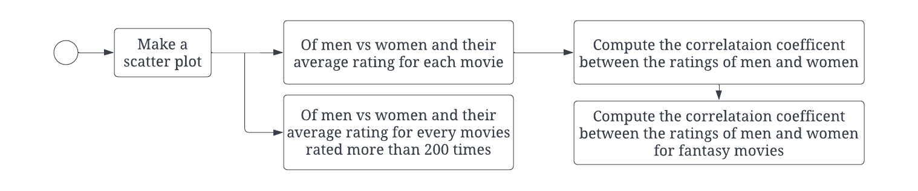
Methodology - Problem 3
Figure: Block diagram of the workflow for problem 3
movie_id | mean_F_rating | mean_M_rating
X | aa | bb
Y | cc | dd
To make a scatter plot, need to preprocess the dataset into this form
Correlation coefficient can be found using pandas corr() method
Notes:
Preprocess by creating 2 separate dictionaries for men and women ratings, get the mean value from them and put it in a new dataframe with only unique movie ids
Used seaborn and matplotlib libraries

Slide 22
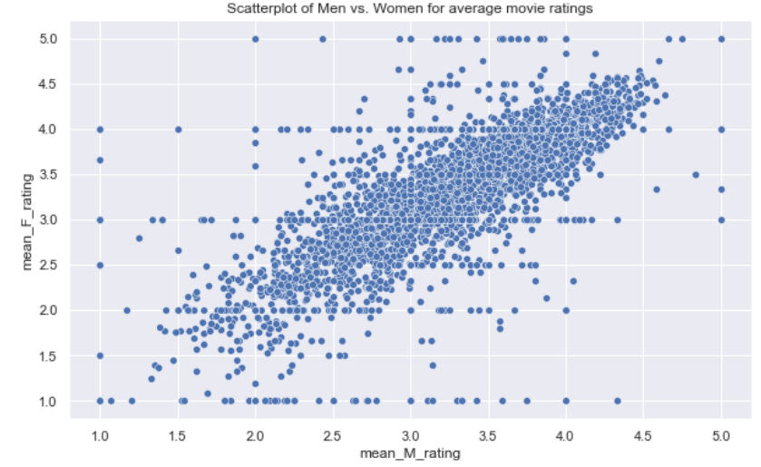
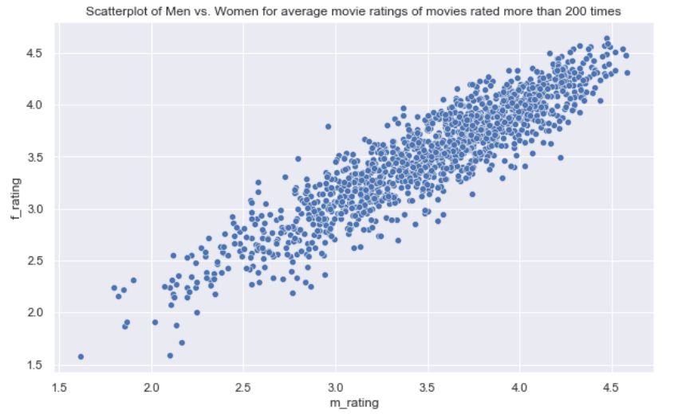
Results - Problem 3
Comparison between scatterplot for all movies vs movies rated more than 200 times
Figure: Scatterplot of Men vs Women for average movie ratings
Figure: Scatterplot of Men vs Women for average movie ratings of movies rated more than 200 times
Notes:
All movies - lot’s of outliers, lesser known movies with less reviews
Movies more than 200 ratings - more correlation, positive

Slide 23
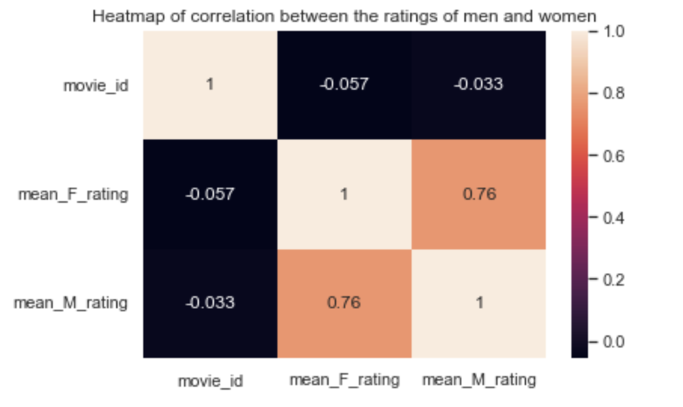
Results - Problem 3
Under what circumstances the rating given by one gender can be used to predict the rating given by the other gender
Conjecture: Fantasy movies are usually received similarly by both the genders. So these genres of movies can be recommended to both the genders.
Figure: Heat map for correlation between men’s and women’s ratings
Notes:
Decent some correlation but not the best

Slide 24
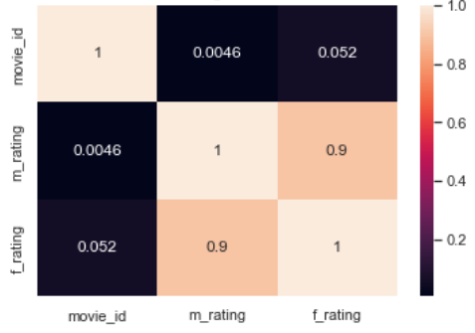
Results - Problem 3
Conjecture: Fantasy movies have a higher correlation coefficient so this genre of movies can be recommended to both the genders.
Figure: Heatmap of Correlation between the ratings of men and women for fantasy movies
Notes:
Add figure label
What we are doing?
How we are doing?

Slide 25
Business Question
Which movies would a user be most interested in watching based on other users with similar interests?

Slide 26
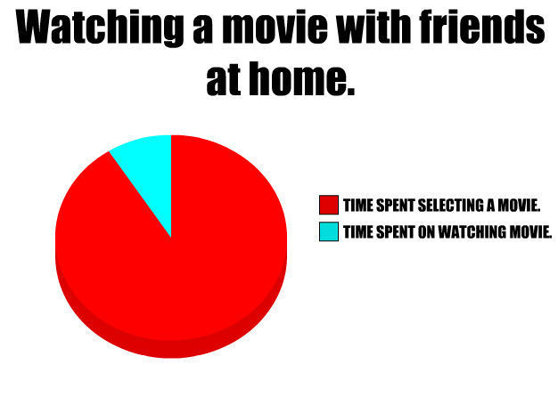
Business Question:
How much times do you guys spend on deciding what movies to watch?
Figure: Pie chart meme

Slide 27
Solution
Recommendation System with Collaborative Filtering

Slide 28

Business Question- Solution
What are recommender systems?
A recommender system is an information filtering system that seeks to predict the "rating" or "preference", a user would give to an item.
Figure: Meme stating that recommender systems have multiple application

Slide 29
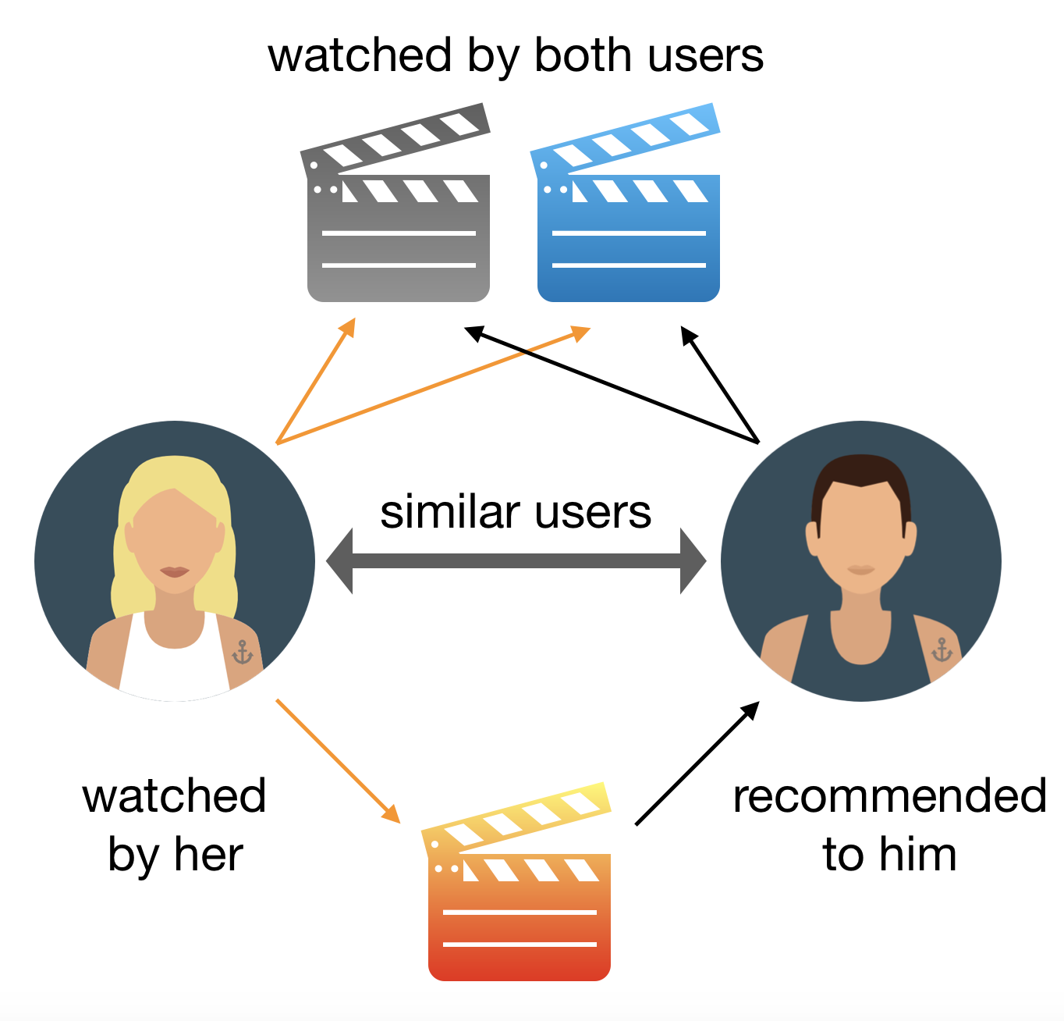
Business Question- Solution
What is collaborative filtering?
The idea is to consider users’ opinions on different movies and recommend the best movie to each user based on the user’s previous rankings and the opinion of other similar types of users.
Figure: Collaborative filtering

Slide 30
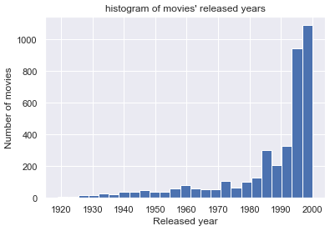
Data Exploration - Movie Dataset
We looked into the histogram of the movie’s year of release.
Key insights:
Most movies reviewed are recent movies
Oldest movie reviewed in the dataset is from the year 1925
Figure: histogram of the movie’s year of release

Slide 31
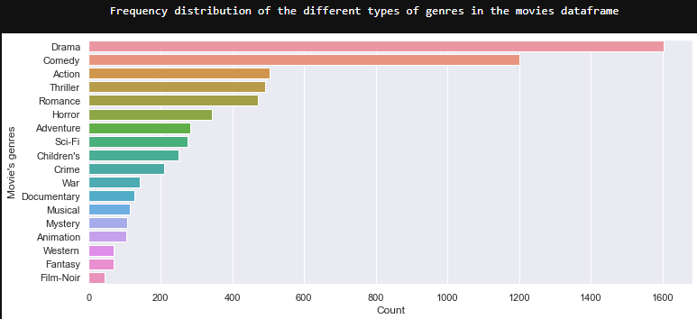
Data Exploration - Movie Dataset
We looked into the frequency distribution of each genre in the movie dataset
Key insights:
Most common genres is Drama
Least common genres is Film-Noir
Figure: Frequency distribution of the different types of genres in the movies dataframe

Slide 32
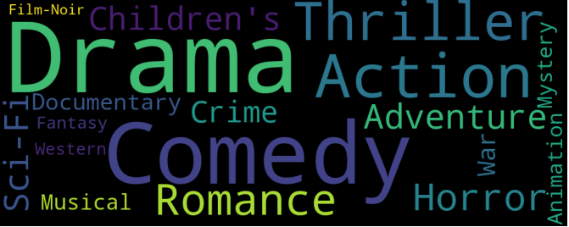
Data Exploration - Movie Dataset
We looked into the frequency distribution of each genre in the movie dataset
Key insights:
Most common genres is Drama
Least common genres is Film-Noir
Figure: Word cloud distribution of the different types of genres in the movies dataframe

Slide 33
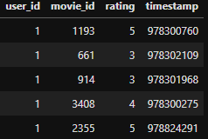
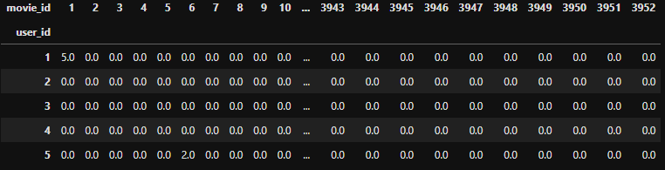
Predictive Modeling- Reformatting the ratings dataset
We reformatted the ratings dataset so that:
There is one row for each user.
There is one column for each movie.
Removed the timestamp as it is unnecessary.
Set missing ratings as 0.0
Figure: Original ratings dataset
Figure: Reformatted dataset
Notes:
Set each row to be a userID, each column to be a movieID, and the intersection to be the rating.

Slide 34
Predictive Modeling:
Denormalized the dataset
Ratings_demeaned = Rating - user_avg_rating
Check sparsity of dataset
sparsity = 1.0 - len(ratings) / [len(users) * len(movies)] = 95.7%
Notes:
SVD singular value decomposition

Slide 35
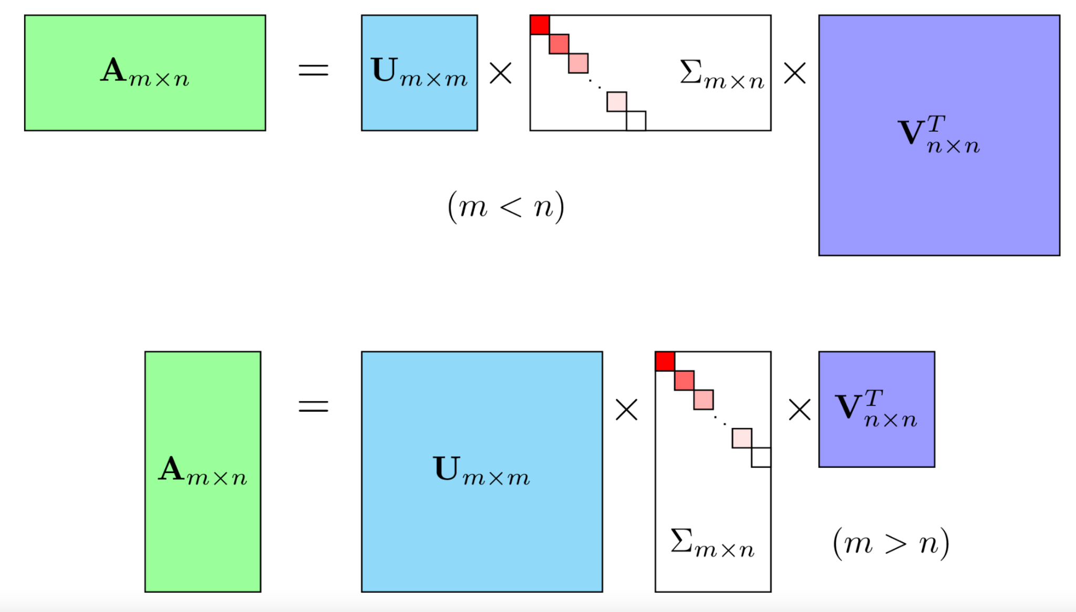
Predictive Modeling
Mathematically, it decomposes A into a two unitary matrices and a diagonal matrix
A is the input data matrix users's ratings for each movie.
U is the user "features" matrix.
Σ is the essentially weights/strengths of each concept.
V^{T}is the movie "features" matrix.
Figure: Singular Value Decomposition (SVD)
Notes:
SVD singular value decomposition

Slide 36
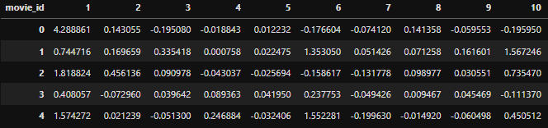
Predictive Modeling - Prediction Matrix
Formed a prediction matrix from the rating dataset
Predict the ratings a user would give to a movie they haven’t rated yet.
Figure: Reformatted dataset
Figure: Prediction Matrix

Slide 37
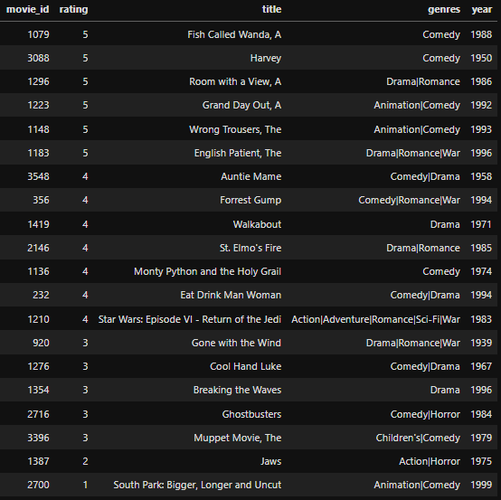
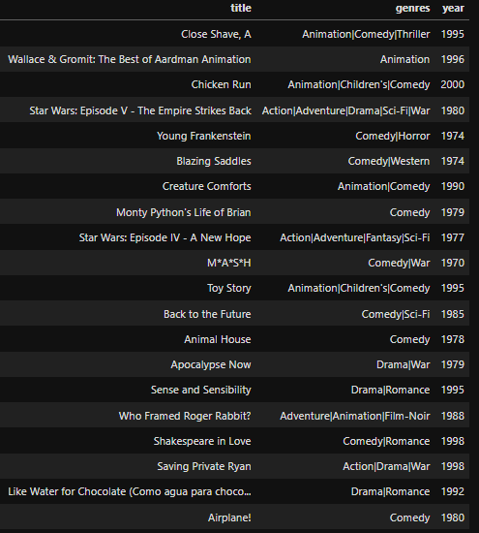
Prediction
Figure: Ratings already given by user 6083
Figure: 20 movies recommended to user 6083
Notes:
Wrote a function that returns the movies with the highest predicted ratings that the specified user hasn’t already rated.
Parameter: prediction matrix, userID, the original movies and rating datasets, the number of recommendations that should be outputted

Slide 38

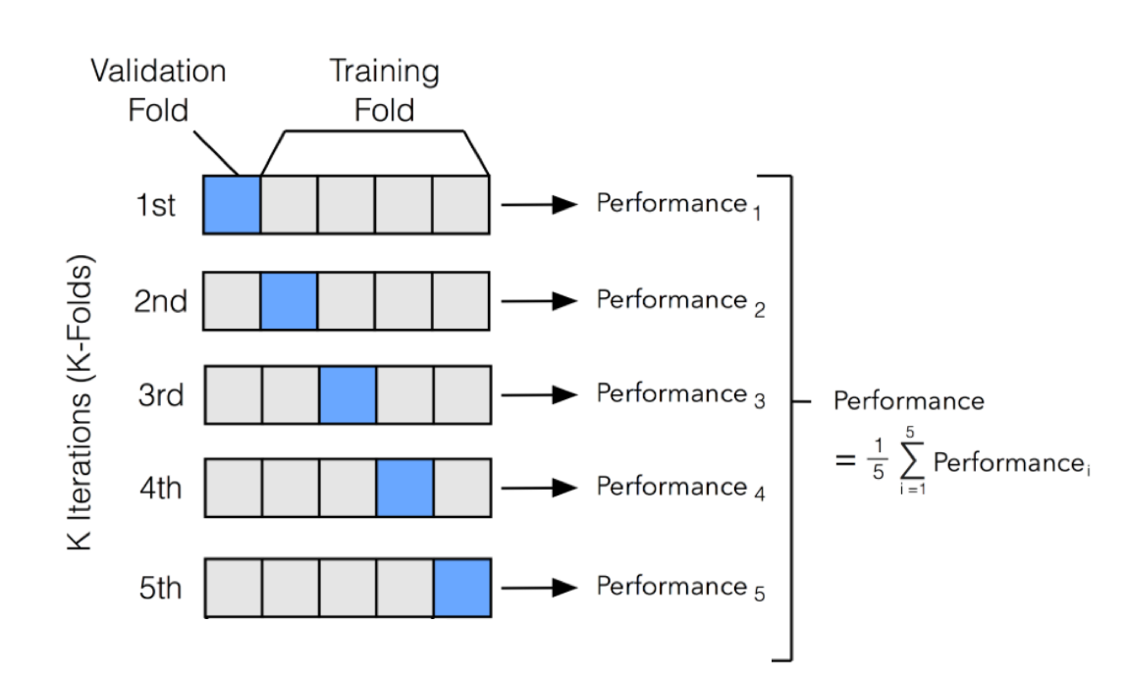
Model Evaluation
Utilized Surprise library
Evaluated the RMSE with 5-fold cross validation of the MovieLens dataset
Resulted in a mean Root Mean Square Error of 0.87.
Built a training model.
Get estimated rating using predict() method.

Slide 39
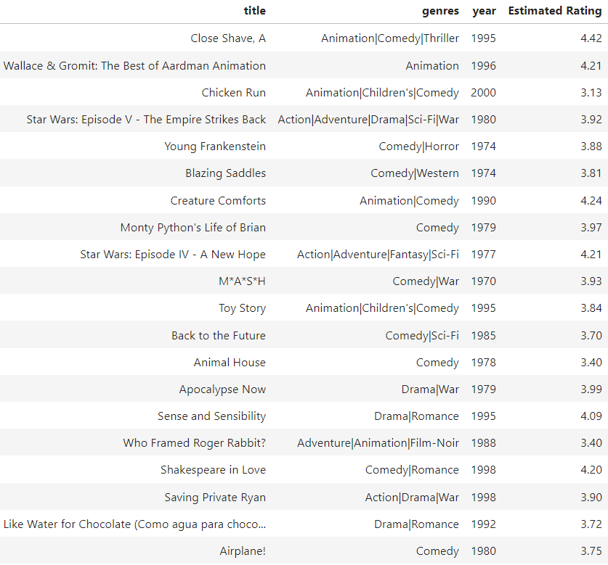
Model Evaluation
Estimated ratings of the 20 recommended movies to user 6083
Average Estimated Rating of 3.89

Slide 40
Conclusions
Problem 1: Men are pleased by Action movies. Women are pleased by Romance movie
Problem 2: People in their age range like the genre movies made for them more
Problem 3: Fantasy genres of movies can be recommended to both the genders
Problem 4: People would be interested in the movies based on the other users with similar interest.

